Slide 1
Strategic Technology Assessment and Integration Plan
Council Grove
March 6, 2015
Onsite Visit

Slide 2
Urgency for Change
The changing landscape of the world’s information to digital form will require today’s student to have a different set of skills than what was required just a decade ago. Future graduates must be equipped with not just the three R’s, but also with 21st century skills of problem solving, critical thinking, communication, and technological literacy.
Students will need to be able to quickly find, synthesize and communicate information and collaborate with colleagues--not just in their own office, but within a global community of colleagues and customers.
Notes:
Mention communication….

Slide 3
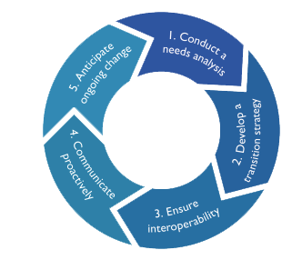
Moving from Vision to Action
Creating a Technology Vision
1
Develop District Technology Goals
linked to Strategic Plan
Action Plan Items
2
Develop Action Plans
3
Create Monthly Timelines
4
Anticipate Ongoing Change

Slide 4
Summary of Current State
District leadership and board ready to move to digital era
Budget issues
Staffing questions
Noticeable optimism of continuous improvement under Superintendent Conwell’s leadership
Variety of instructional programs and mix of autonomy and central decision making
District is generally performing at or above other districts in state testing mandates
Shrinking school populations
Varying levels of technology use and adoption/acceptance among staff in grades/subject areas

Slide 5
Summary of Current State
Insufficient bandwidth in schools
Limited professional development for technology/curriculum integration
District and school websites provide communication to the community, however teacher websites are lacking
Partial or non-existent data integration between systems
Technology use remains teacher centric with some exceptions
Significant student recognition of the power of and need for technology

Slide 6
Areas Ripe for Improvement
Network response time
Professional development (tech skills needs assessment for all staff – certified and support)
(Individualized training, online training, just in time (step-by-step)/job embedded...)
Staff and student secure logins are necessary
Lack of robust/reliable infrastructure and resources impedes interest in moving forward with innovation
Wireless capacity needs expansion
Uniform minimum classroom technology standards
Need tech support ticketing system (data lacking)
Lack of just in time classroom technology support/coaching
Lack of enterprise-wide data architecture
Fulltime technology leader with skills in instructional and network technology (Technology Director)

Slide 7
What is working…
Leadership and board recognized the opportunity to build a 21st century school district.
The technology support teachers are knowledgeable, helpful and well respected.
PowerSchool system training has worked.
Many new teachers are coming in with tech awareness and skills.
Mobile carts are well utilized.
“iPads work well, but for real work, give me a laptop”
Acquring laptop and desktop machines – aiming for 1-1
Can access files from home and anywhere on campus. (Google drive)

Slide 8
Needed Policies
Adopt a plan of obsolescence with standardized life-cycle for hardware and management systems
Incentives for teachers to gain and properly utilize technology to advance student learning
Institute technology competencies for teachers, students, administrators and support staff
Terms of service agreements for equipment
Need curriculum for technology fluency and digital literacy
Need teacher performance expectations for classroom technology integration
Modify, formalize and expand technology committee composition and roles
Create process to vet proposed materials
Integrated data management systems use and interoperability
Updated district and school technology plans
Adopt efficiency measures to free up funding for technology leadership and tech support

Slide 9
Instruction

Slide 10
Instruction - Current State
Principals focused on programs with autonomy
Managed inconsistency
3 types of devices, 3 operating systems
Mixed school/district curriculum control
No formal policy for replacement cycle
Not defined instructional technology framework
Varied engagement of instructional technology within classrooms
Some libraries function as media centers
Mobile carts are fully utilized

Slide 11
Instruction - Current State
Varied data driven decision making central office/classroom
Some digital curriculum on iPads
No learning management system/adaptive platform for delivering digital materials
Alignment of technology to curriculum is being discussed
No technology curriculum and competency framework for teachers and students is in place

Slide 12
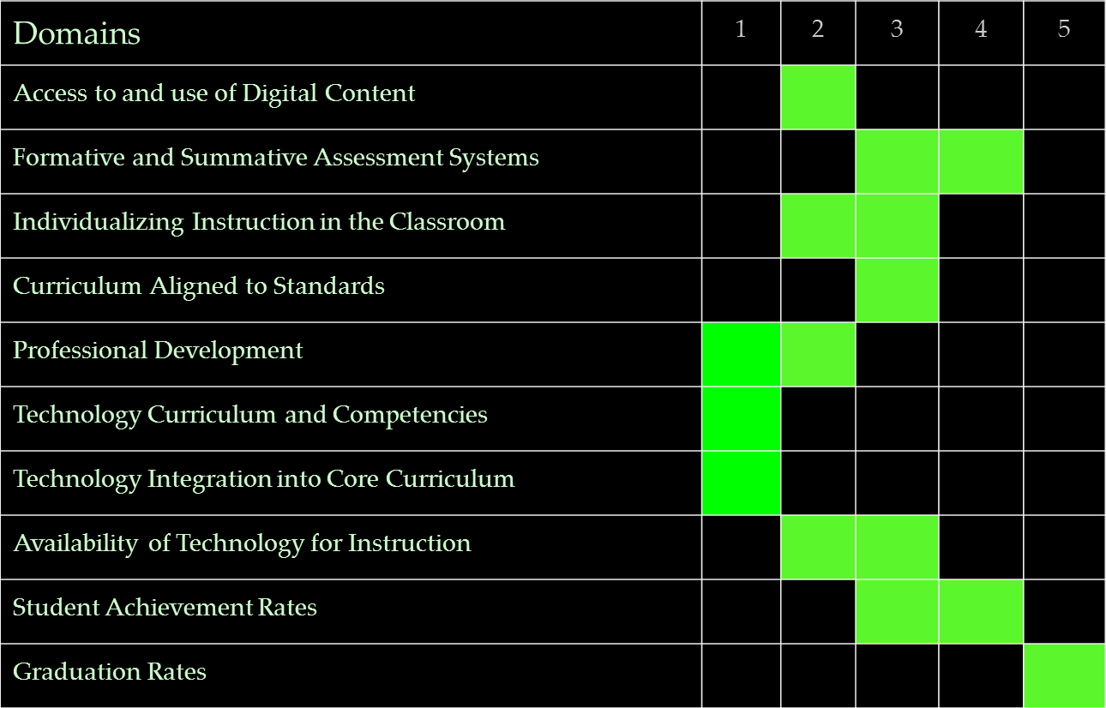
Instruction - Dashboard
Low Average High

Slide 13
Instruction - Target State
Classroom instruction should shift to a learner centric model where technology supports, individualizes and extends learning opportunities
Minimize teacher management processes
Focus on student data driven decisions and individualized instruction
Move towards 1:1 computing for personalized learning
All instructional materials digital and linked to appropriate standards

Slide 14
Instruction - Target State
Adaptive assessment and adaptive instruction should drive personalized learning
Sharing of effective programs and best practices between schools
Graduates required to demonstrate:
Learning in context, critical thinking skills, use of technology for finding/analyzing information and producing presentations
Increase fluency with non-text materials
Clear understanding of tech integration expectations and measures (NETS – S, T & A)

Slide 15
Instruction - Target State
Consolidation of schools maximizing resources and course offerings - virtual courses part of day
Increased use of analytic tools
Walk through processes for teachers, principals, and support personnel
Process to vet recommended and approved materials

Slide 16
Instruction - Target State
Robust repository for digital materials
Standards-based best practices shared in repository
Collaborative Learning Management System (LMS) is used by all teachers and students
Use of interdisciplinary activities between content areas
Adoption of standards for technology integration (NETS) and tied to principal walk throughs (instructional rounds)
Cost of materials and devices will not cost more than current materials

Slide 17
Technology Infrastructure

Slide 18
Technology Infrastructure - Current State
Minimal and varied backup procedures are in place
Disaster recovery/business continuity plan should be formalized (privacy issues)
School infrastructure, WAN and WIFI capacity need to be increased
Wireless currently inadequate and unreliable
Expansion being is being discussed
There is an issue with IP addresses
No formal/standardized device life cycle
Some obsolescent technology being used for students
Use of “group” printers seems inefficient

Slide 19
Technology Infrastructure - Current State
Technology procedures and policies are not in place to support the 21st century classroom
Not enough student devices for online testing model or full student use in all schools
No full time staff responsible for infrastructure and support

Slide 20
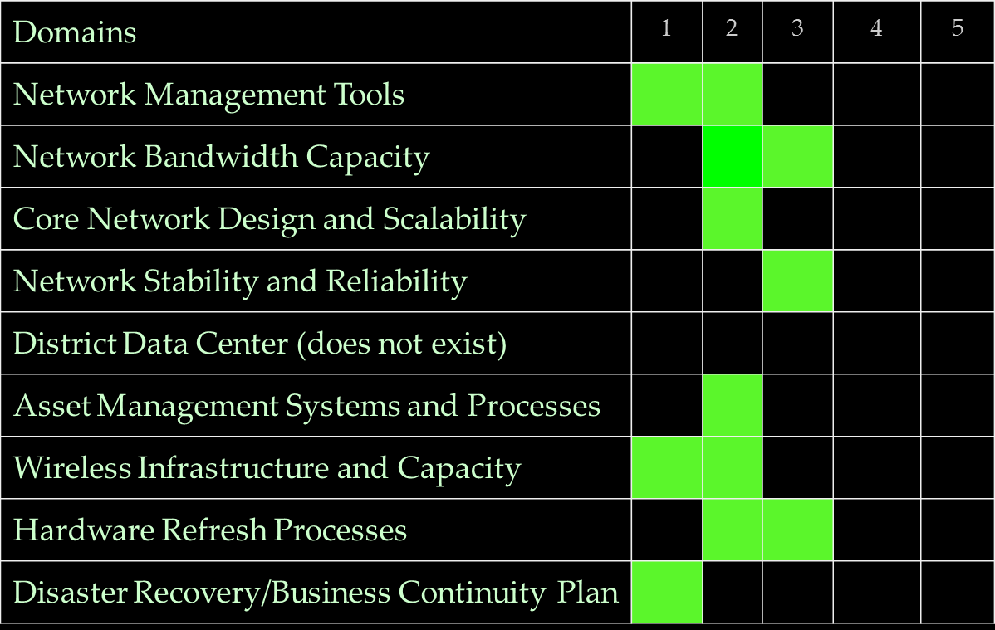
Technology Infrastructure - Dashboard
Low Avg High

Slide 21
Technology Infrastructure - Target State
Ubiquitous high density wireless
Increased access to devices for students (1-1 is suggested)
Begin pilots for 1:1 devices
Define clear procedures for adopting/exploring new technologies
Build infrastructure to consistently support multiple services (i.e. video, voice, surveillance)
Mounted projectors for safety and ease of use
Students and parents have ready access to digital content 24/7

Slide 22
Technology Infrastructure - Target State
Secure, individual log-ons
Bring your own device district wide
Secure and defined data security procedures and policies
Clear, defineable assistive technology plan

Slide 23
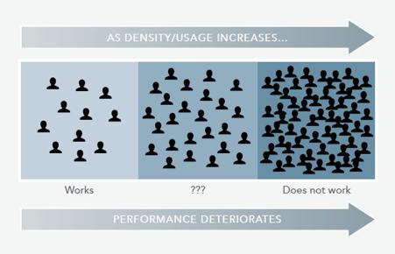
Infrastructure Target - Wireless

Slide 24
Management Systems

Slide 25
Management Systems - Current State
Student Information System (PowerSchool) adequate
No apparent data analytics system
No comprehensive data warehouse
Potential lack of strategic data integration
Many discrete management systems in silos
Partial or non-existent data integration between systems
Notes:
Fire drills, no support for

Slide 26
Management Systems- Dashboard
Domains | 1 | 2 | 3 | 4 | 5
Learning Management System | NA
Curriculum Management System | NA
Student Information System
ERP (HR/PR/FI) Systems
Special Education System (unknown)
Transportation System (unknown)
Food Services System
Parent Portal
Data Warehouse and Analytics
Low Avg High

Slide 27
Management Systems - Target State
Increase interoperability and data sharing between all systems
Implement data workflow plan that outlines data to be shared between systems
Implement a data architecture with backups that minimizes dependencies
Adopt learning management system platform
Adopt and establish uniform standards for website content creation and communication
Establish review process and adoption procedures for management systems that include all stakeholders

Slide 28
Management Systems - Target State
Make widely available professional development, documentation, and support for all management systems
Efficiencies and improved district communication could be accomplished with a sophisticated, formal web and social media plan/strategy
Conduct a thorough review of stakeholder reporting needs
Rich data insight at all levels
Implement a data warehouse and/or define analytic tools

Slide 29
Technology Organization

Slide 30
Technology Organization - Current State
Part-time staff is well respected, but ability to provide comprehensive support is extremely limited.
School based tech support is knowledgeable but task-limited due to other full time responsibilities.
Priorities are determined opportunistically
Triage often drives decisions
No integrated technology roadmap guides the organization
General focus is reactive not proactive
Autonomy at the site level has sometimes created a lack of coordination

Slide 31
Technology Organization - Current State
Current part-time and school based tech support staff are over taxed
Contracted IT staff provides an approach to plans and issues on a just-in-time basis
Common Themes:
Focus on outside support, asset management not consistent nor thorough
Principals have site autonomy
No comprehensive infrastructure plan
No full time IT staff creates demands and impacts instructional time

Slide 32
Technology Organization - Dashboard
Domains | 1 | 2 | 3 | 4 | 5
Technical Support/”Break-Fix”
Network Management Support
Instructional Technology Support at District Level
Instructional Technology Support at Building Level
Help Desk Operations (does not exist)
Applications Support
Reporting Structure and Roles
Staff (Faculty) Tech Competency Levels (unknown)
Low Avg High

Slide 33
Technology Organization - Target State
Schools- Teacher coaches become building based instructional technology coaches
Provides feedback and support for teachers as well as walkthrough

Slide 34
Technology Organization - Target State
Establish district technology leadership position
Responsible for technology vision, thought leadership, change agency, and evangelism
Responsible for technology strategy and long term plan
Oversees instructional technology
Oversees infrastructure
Service level agreements – coordinate technology plan with each school
This position should have a direct relationship to curriculum leaders with a shared responsibility to:
Run training programs
Oversee technology curriculum selection
Identify and coordinate digital curriculum
Supervise building level instructional support (coaches/technology)

Slide 35
Technology Organization - Target State
Create formal Help Desk system for all support issues
Use data to drive decisions and plan use of resources
Develop a strategic technology and learning plan that provides the blueprint to create a community foundation to provide added technology resources (funding)
Seek system and structural efficiencies to provide diverse funding shifts

Slide 36
Getting to the Target Environment in 2016

Slide 37
Implementation Timeline
 | Instruction | Infrastructure | Management Systems | Organization
3 months | Get formal reviews regarding audit from School board Principals Committee Parents Tech staff Curriculum staff Reorganize the technology committee. Committee and principals visit quality school districts who have a record of success Ed Tech | Improve building level Wi-Fi access and infrastructure Improve WAN/Network upgrades Discuss feasibility of 1-1 pilot | Research LMS/ adaptive instruction system (PD) Discuss web strategy/ communication plan for enhanced communication with community and staff | Begin development of district wide tech policies Create district tech leadership position Survey staff as to ideal professional development needs and offerings.

Slide 38
Appendix

Slide 39
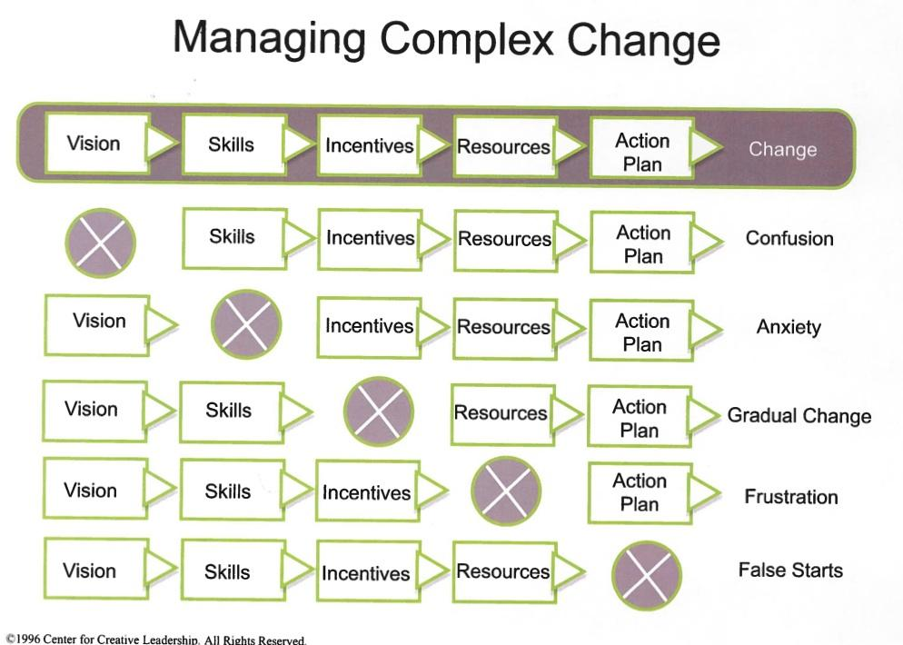
Managing Complex Change
Notes:
Greg

Slide 40
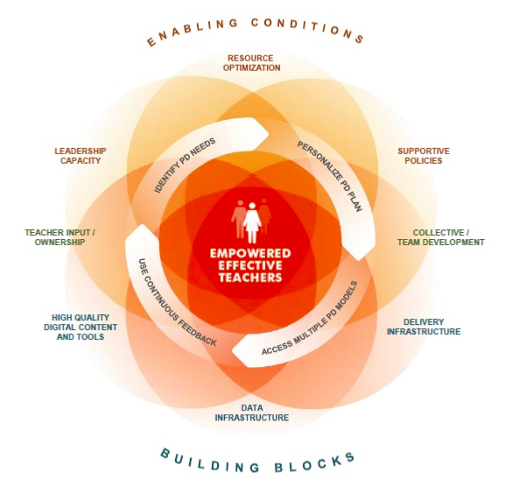
Creating the Conditions for Effective Professional Development

Slide 41
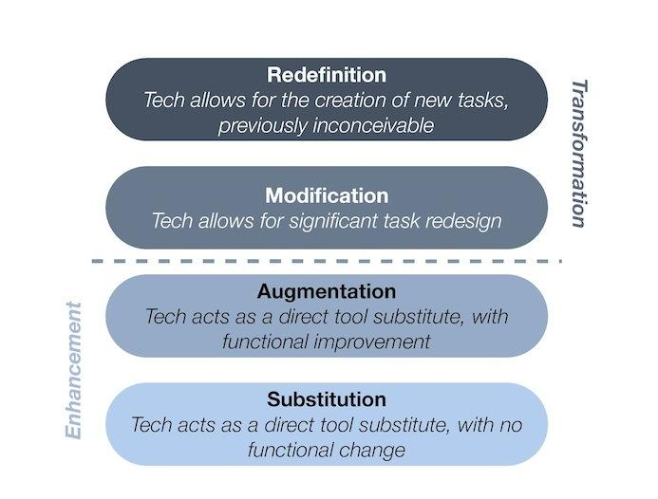
Measurement of Instructional Technology SAMR Model

Slide 42
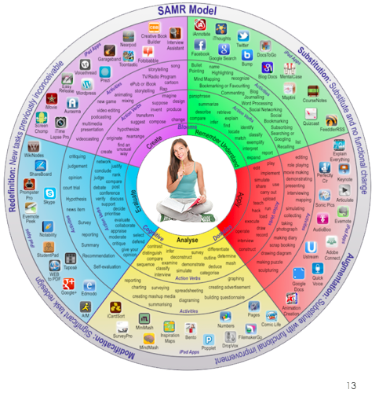

Slide 43
Useful Links for Further Research
Exemplary Tech Savvy School Districts
High Tech High (charter K-12 school District + Grad. School)
http://www.hightechhigh.org
Kent School District
http://www.kent.k12.wa.us/site/default.aspx?PageID=1
Classroom Technology Integration Rubrics
http://application.jff.org/userImages/files/technology_integration_rubricnew-1-3.pdf
http://www.ascd.org/ASCD/pdf/journals/ed_lead/el201303_johnson_rubric.pdf

